Slide 1




PYTHON PROGRAMMING
SNAKE GAME
Project by:
Aayisha Noora J, CSE-A
Aarthi.E, CSE-A
Agathiya.S, CSE-A
Anupriya.L, EEE
Priya. D, AIDS-B

Slide 2


SNAKE GAME
PYTHON
Python is an interpreted, object-oriented, high-level programming language with dynamic.
Python is a computer programming language often used to build websites
and software, automate tasks, and conduct data analysis

Slide 3

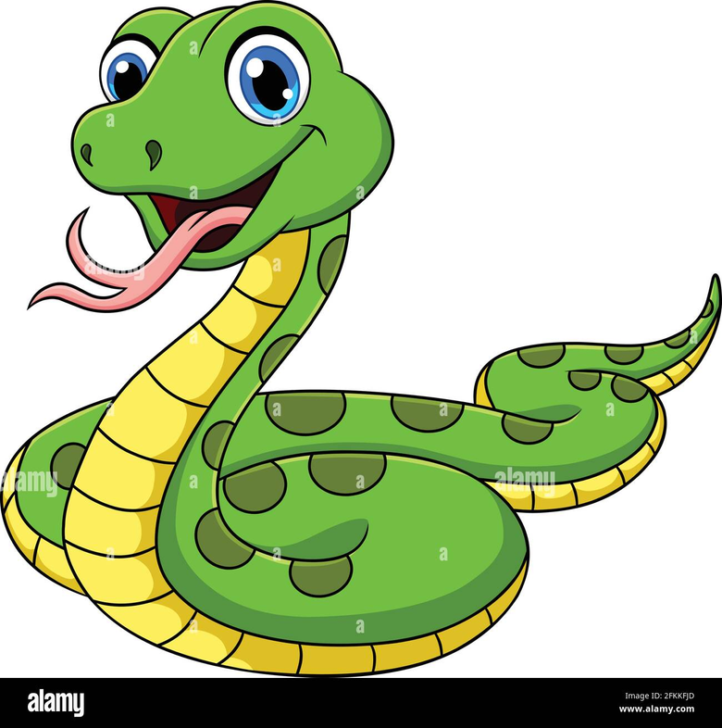

SNAKE GAME
Snake Game Using
Python
Python IDLE
pygame
Snake game is one of the most popular arcade games of all time.
In this game, the main objective of the player is to catch the maximum number
Øof fruits without hitting the wall or itself.
PYTHON
PYGAME

Slide 4
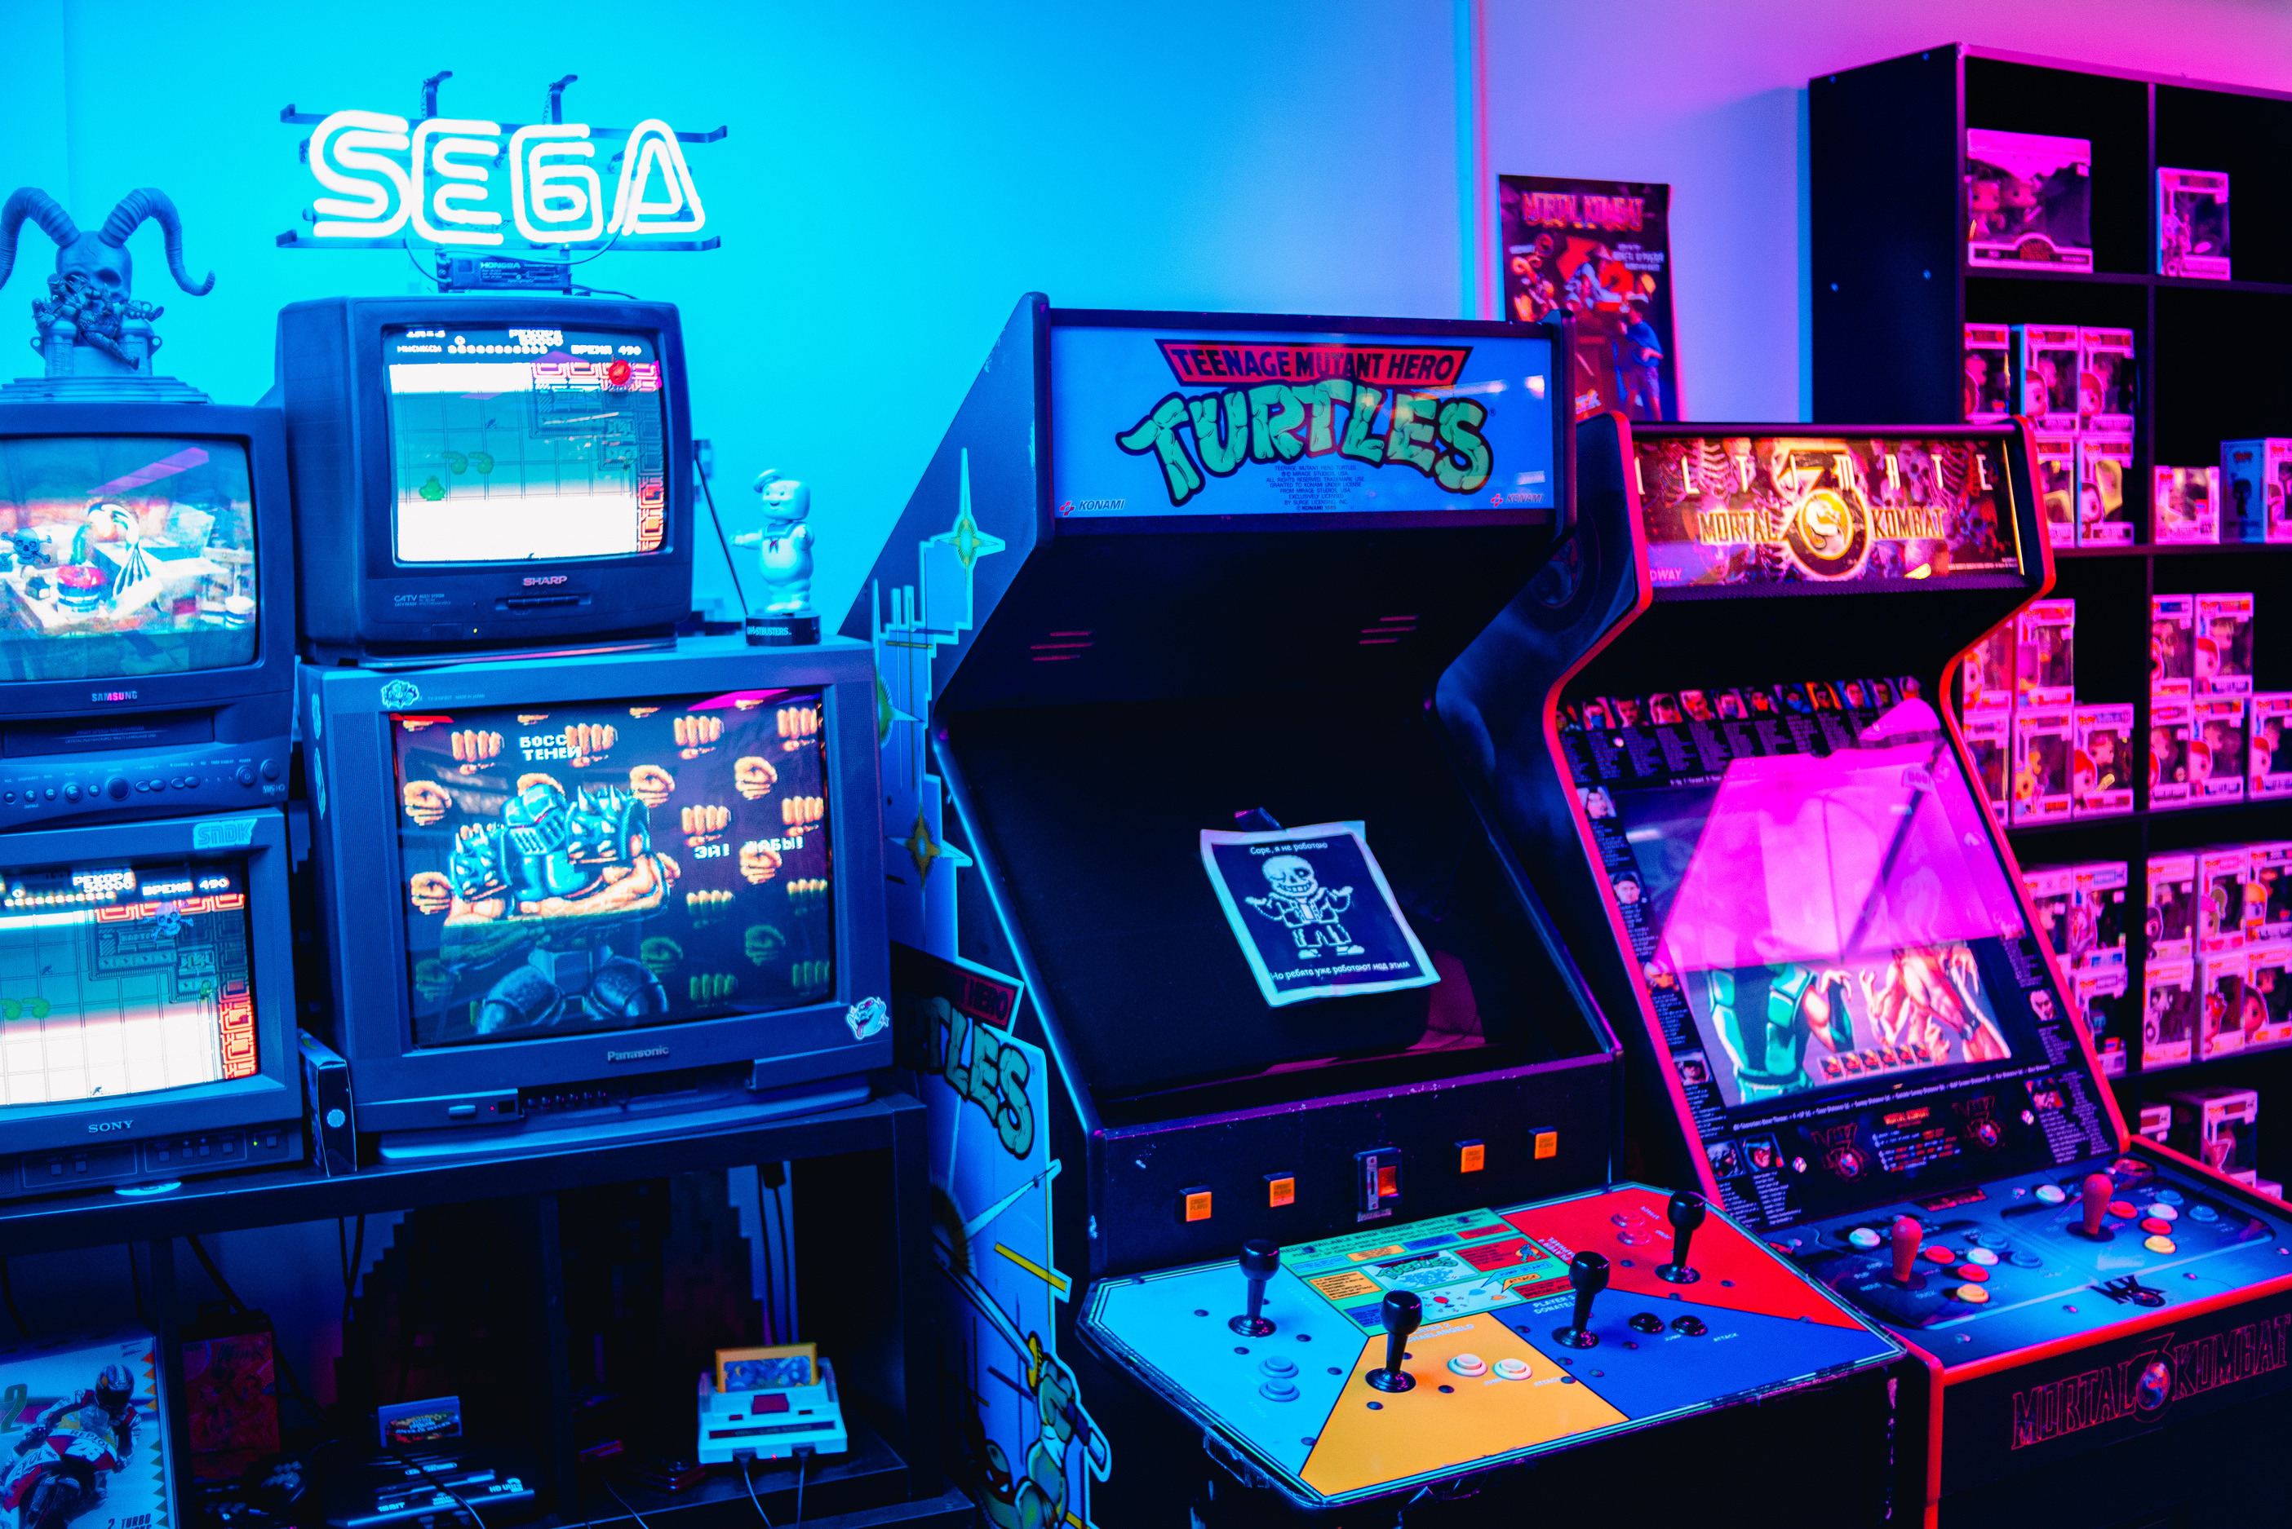


SNAKE GAME
Steps to create SnakePygame
01
Installing Pygame
02
Create the Screen
03
Moving the snake
04
Game over when the snake hits the boundaries
05
Adding the food
06
Increasing the length a screen
07
Displaying the Score
01
Moving the snake
01
Game over when the snake hits the boundaries
01
Adding the food

Slide 5

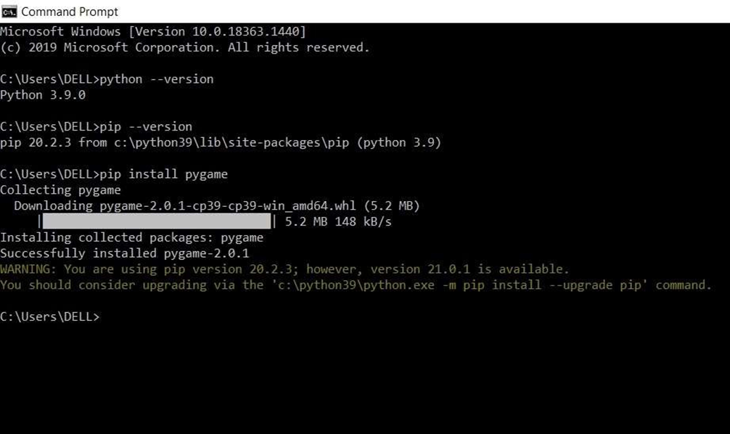
SNAKE GAME
Installing Pygame
To installPygame, open the command prompt and give the command- [ Pip installpygame ]

Slide 6
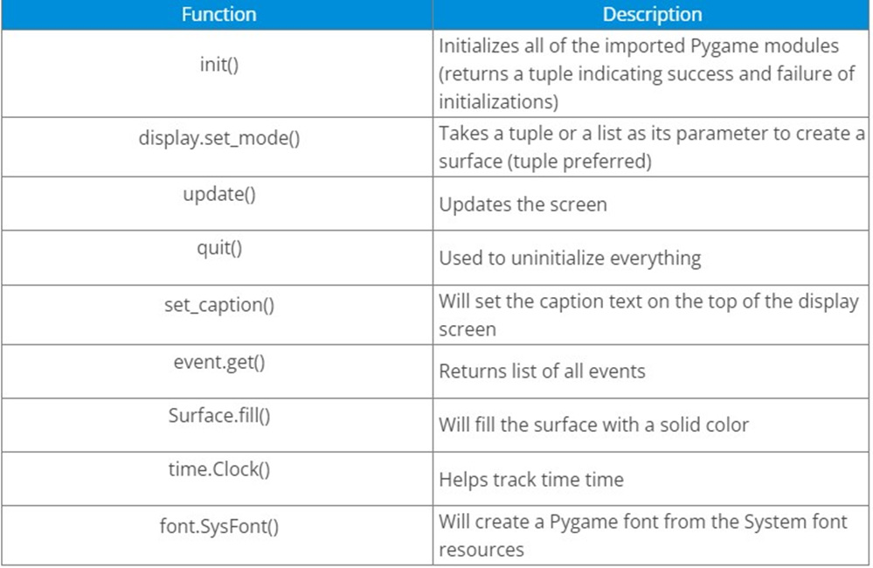
SNAKE GAME
Module and functions use in this project
Pygame :
It is a python programming language library for making multimedia applications like games.

Slide 7

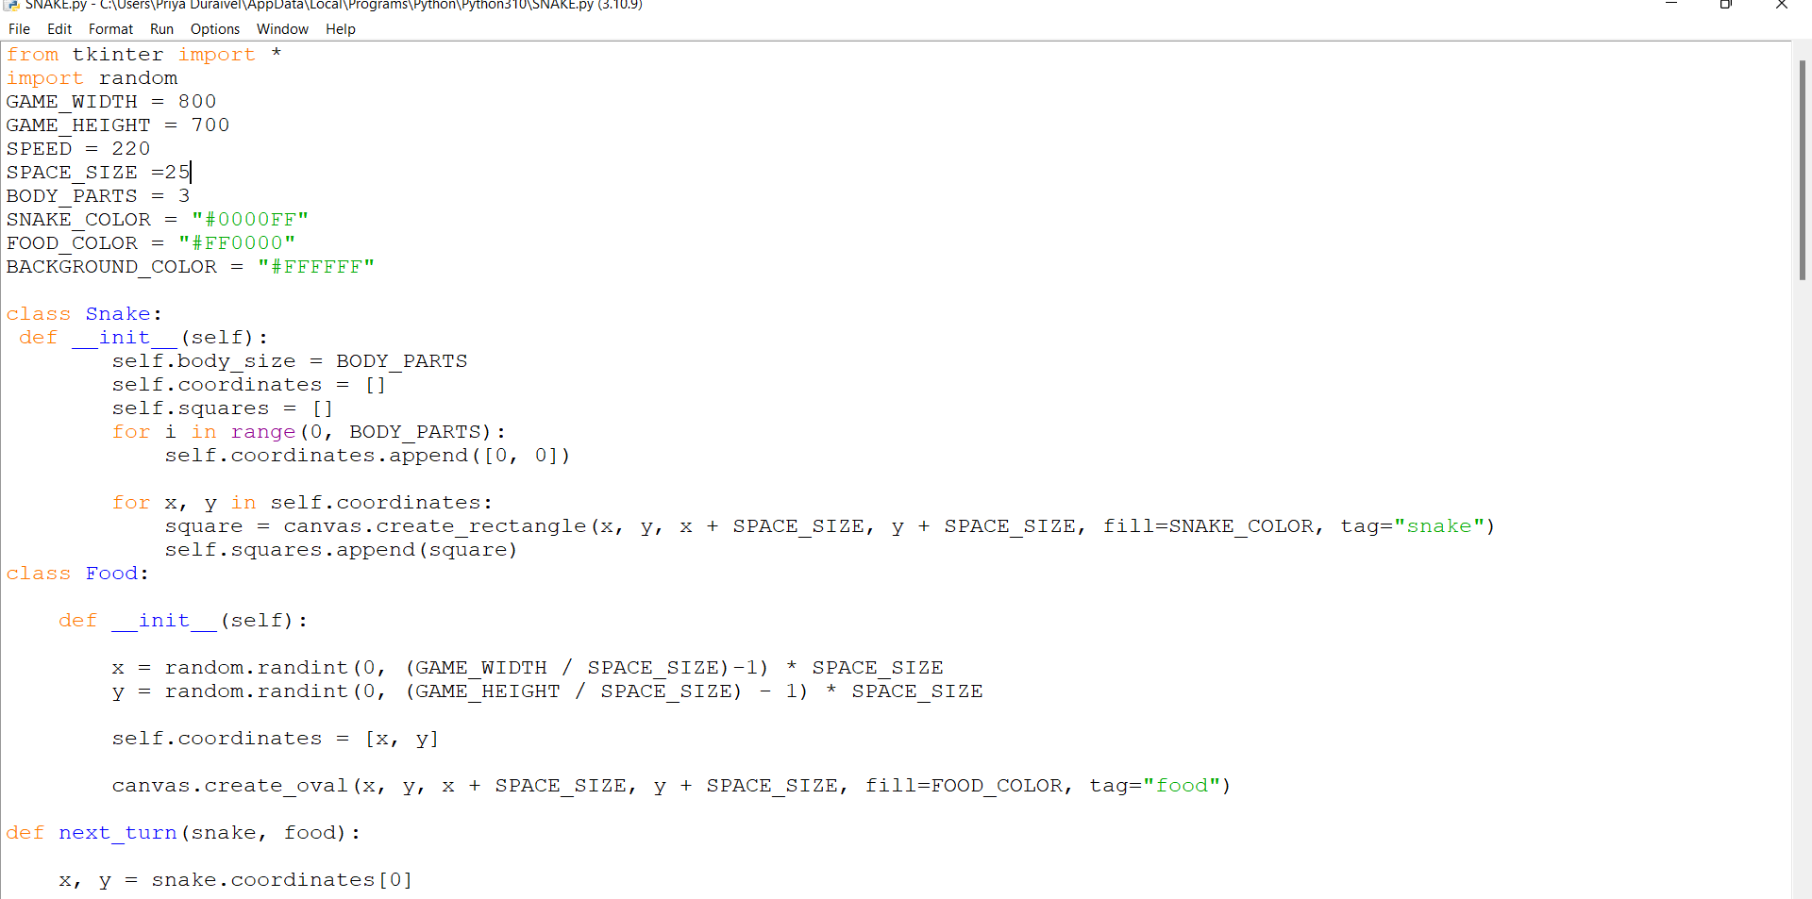
SNAKE GAME
STUDIO SHODWE
"Metaverse is a world in future technology that we will enter later."
- Alexander Aronowitz -

Slide 8
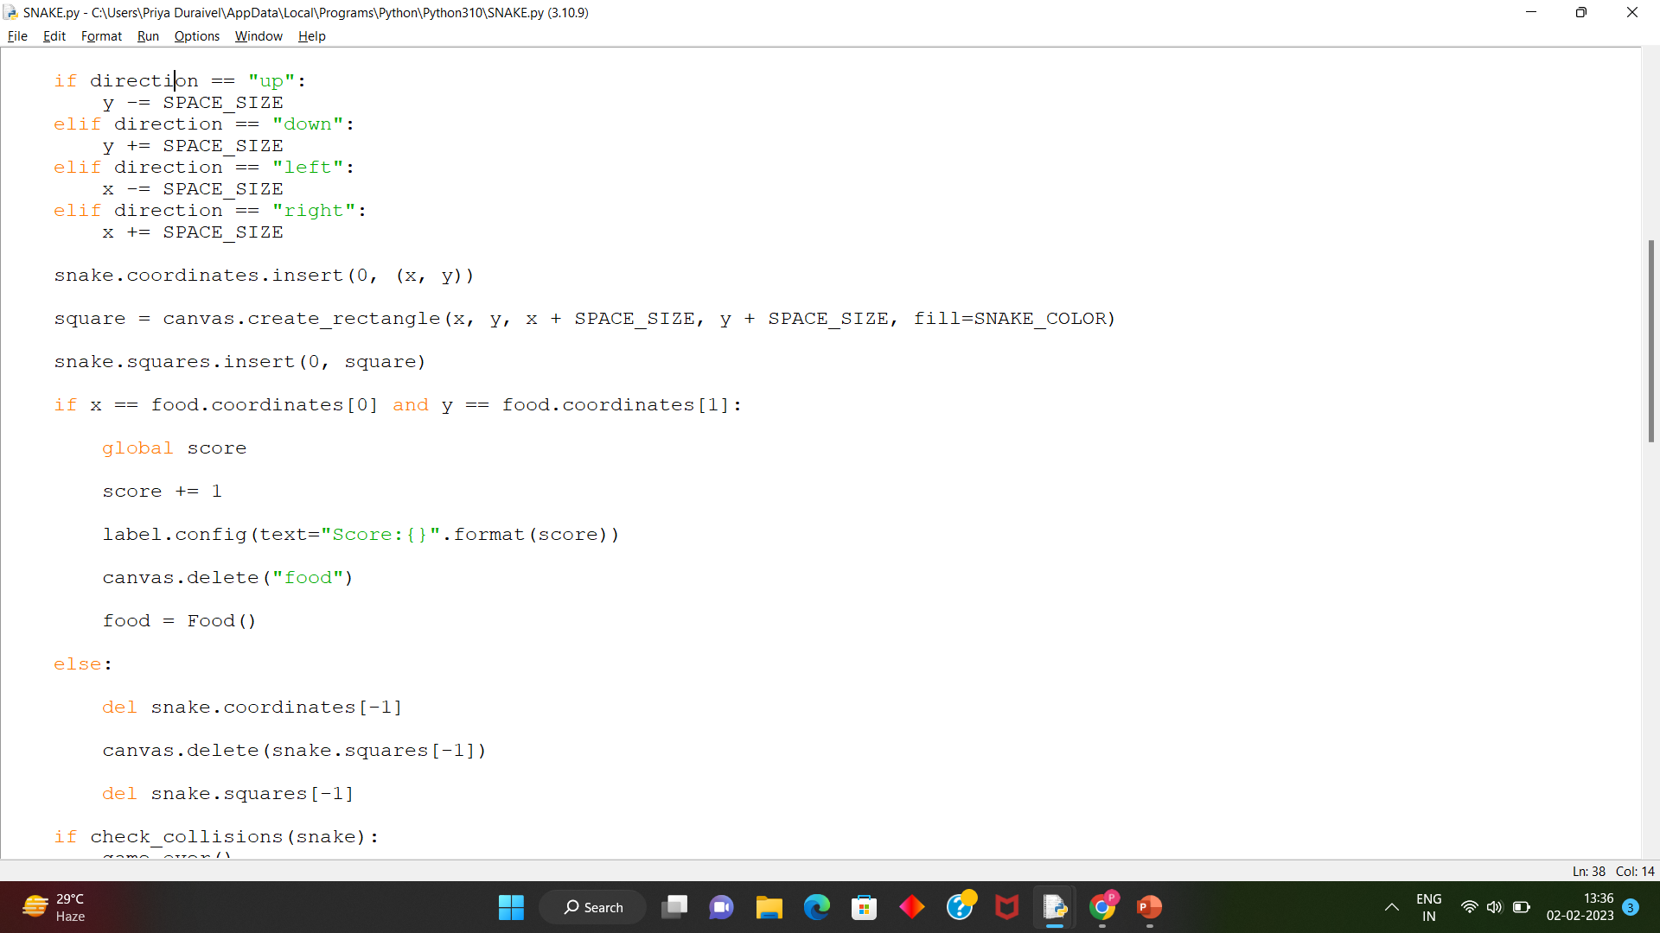
SNAKE GAME
STUDIO SHODWE
"Metaverse is a world in future technology that we will enter later."
- Alexander Aronowitz -

Slide 9
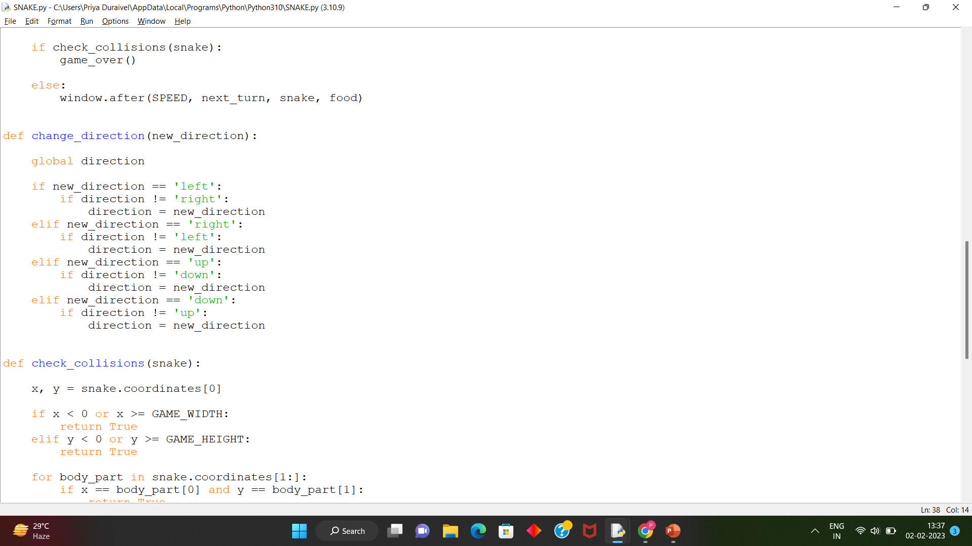
SNAKE GAME
STUDIO SHODWE
"Metaverse is a world in future technology that we will enter later."
- Alexander Aronowitz -

Slide 10
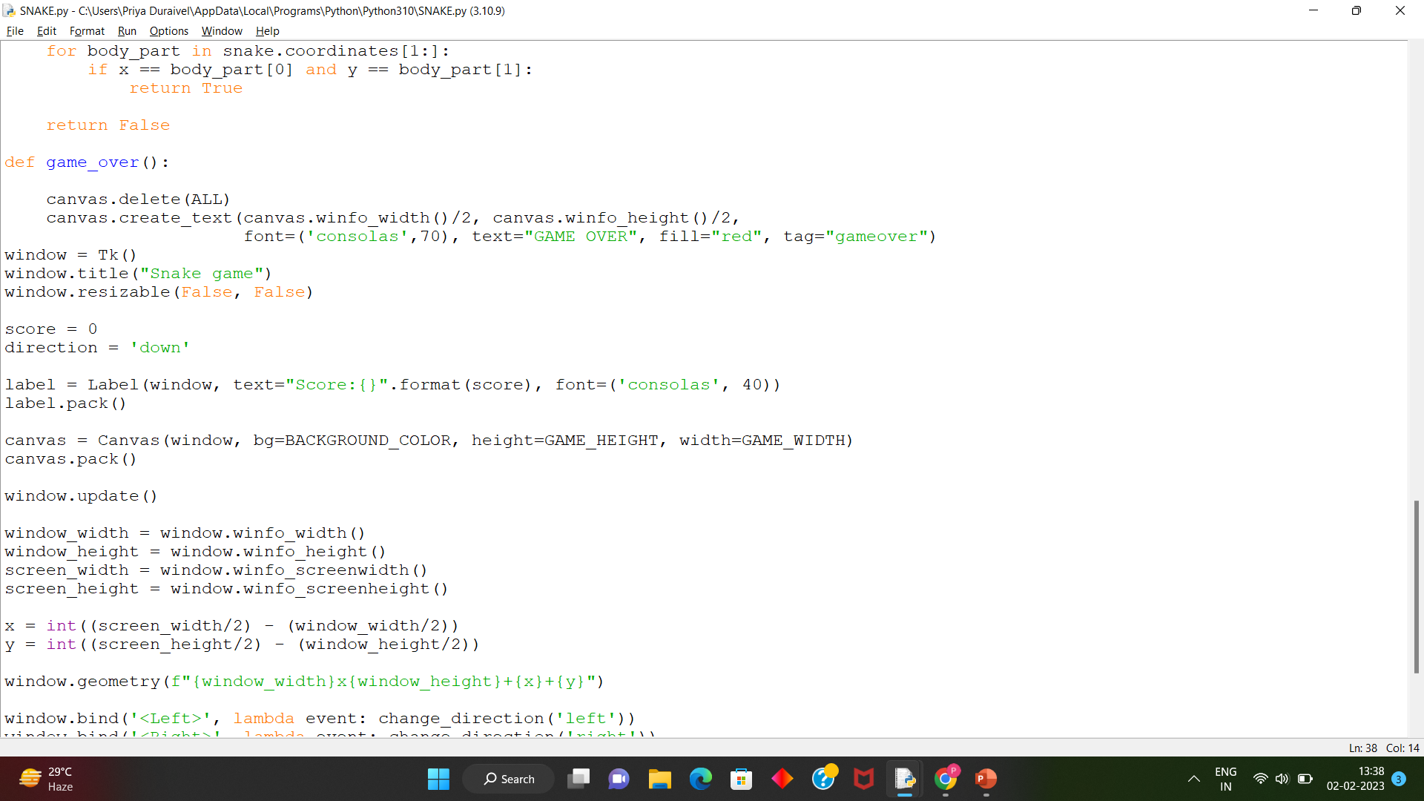
SNAKE GAME
STUDIO SHODWE
"Metaverse is a world in future technology that we will enter later."
- Alexander Aronowitz -

Slide 11
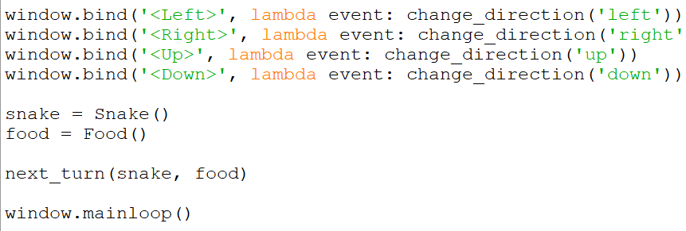
SNAKE GAME
-Source Code-

Slide 12

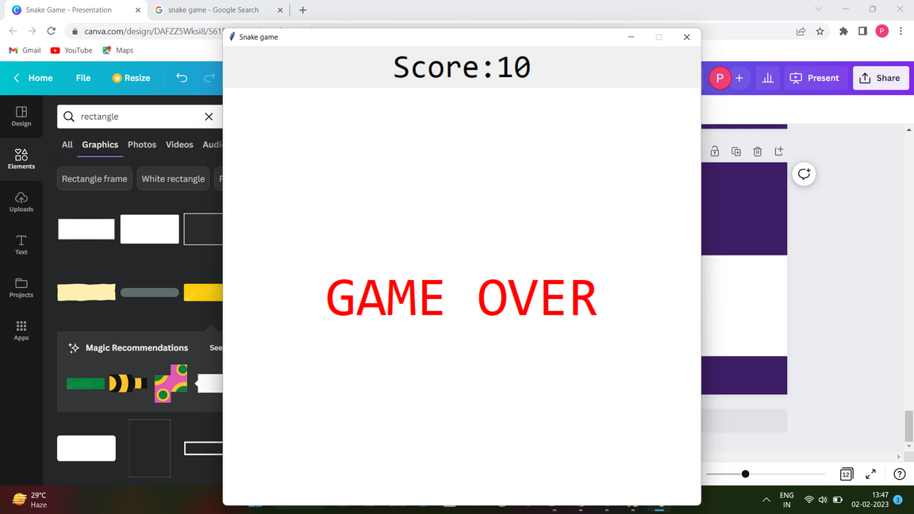
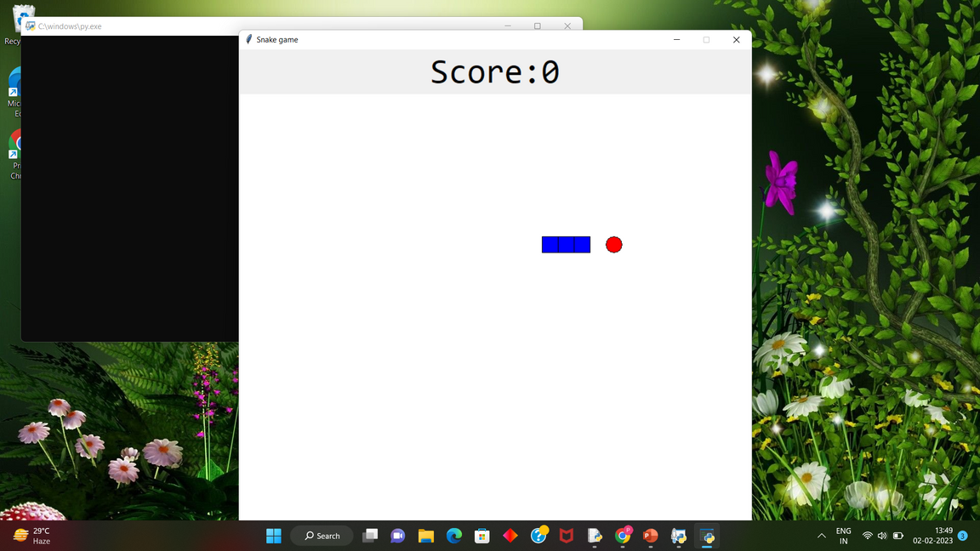
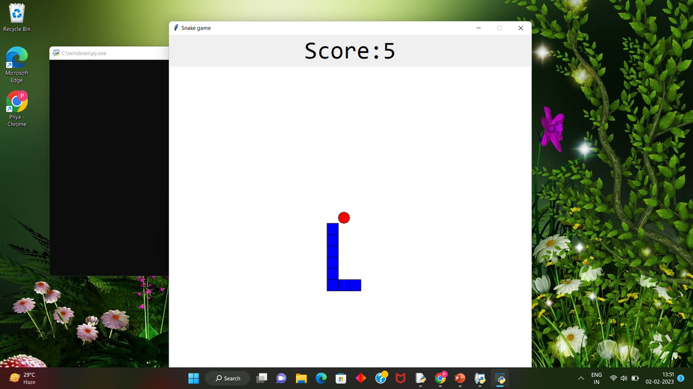
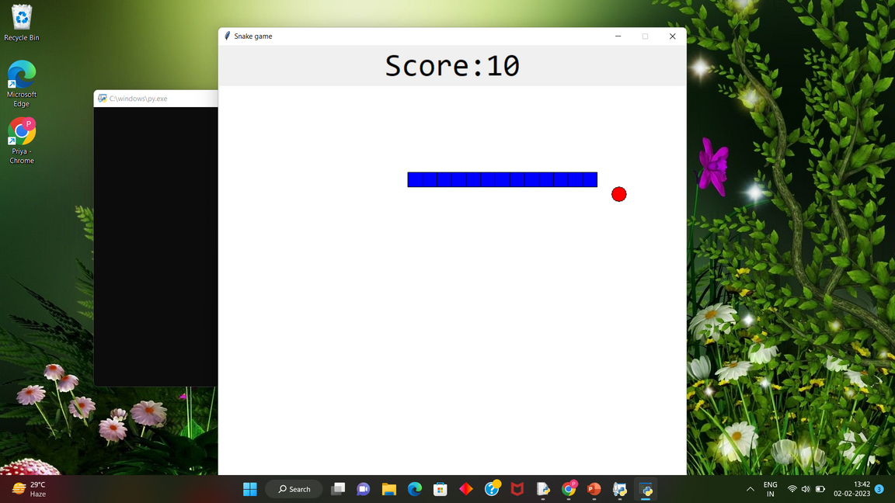
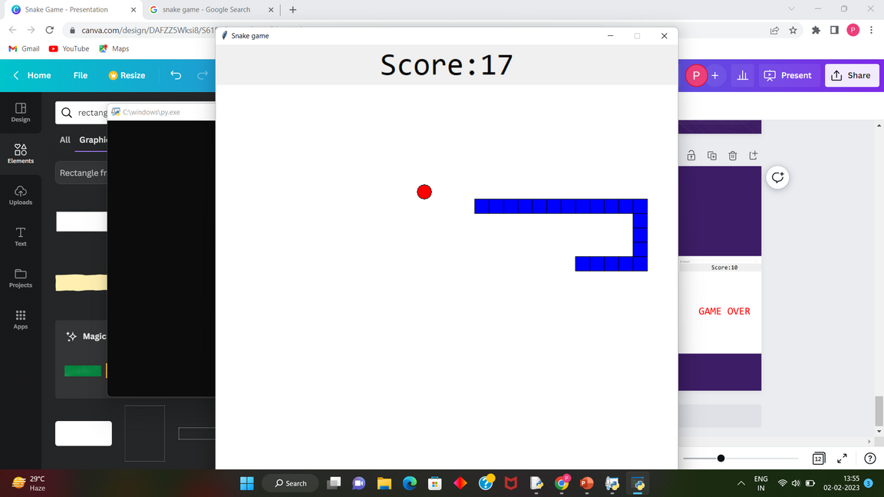
SNAKE GAME
Snake Game Events
Initial Stage
Intermediate Stage
Final Stage

Slide 13
SNAKE GAME
CONCLUSION
I have use somemodule and functions.
Creating a snake game we have have use pygame module here.
After successful creating code we had see the output.

Slide 14

SNAKE GAME
THANK YOU
Project by:
Aayisha Noora J, CSE-A, Aarthi.E, CSE-A ,Agathiya.S, CSE-A, Anupriya.L, EEE ,Priya. D, AIDS-B

